Slide 1



a partnership serving families
The Funeralwise Network of
Planning Specialists and Preferred Providers
Notes:
Thank you for the opportunity to tell you about our services to funeral homes. We see it as a partnership in serving families. We bring a proven collection of digital and personal services to complement the services you offer your community. In doing so, we help you broaden your marketing reach and drive new revenue to your business.

Slide 2

A unique, multi-dimensional enterprise providing end-of-life resources
Notes:
We are affiliated with the Funeralwise network. Our centerpiece is Funeralwise.com, the leading consumer resource on the web. If you click around our site you’ll see that we have everything you need to know about funerals. Our mission is to help people prepare, celebrate and remember. Let’s dive a little deeper into Funeralwise and how it can benefit you.

Slide 3

OUR VALUE PROPOSITION
Meet End-of-Life Needs
Information: Articles, Guides, Forums
Technology: Easy-to-Use Planning Tools
Services: Advisors, Funeral Providers
Products: Financial, Memorial
Community: A User Community that Values and Trusts Us
Primary Target: Age 55+
3
Notes:
The primary target audience for Funeralwise.com is Baby Boomers but not exclusively, we do get traffic from all age groups. What our community of users likes about us is that we provide them lots of free information…
Visitors to Funeralwise.com have free access to hundreds of articles, downloadable guides, and an interactive forum. They have free use of the Wise Planning System for do-it-yourself planning. The system connects them with expert advisors for free funeral planning assistance and also connects them with funeral homes like yours. As advisors, we offer financial products, such as preneed insurance, to fund funeral plans. We could bring these funded preneed plans to you. The collection of resources we offer enable us to build a user community that values and trusts us.

Slide 4

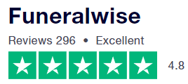
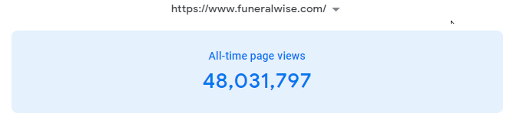
THE GO-TO SOURCE FOR FREE, UNBIASED, AND INDEPENDENT FUNERAL-RELATED INFORMATION
Privately-held company, since 2008
Arms-length relationship with funeral homes and other funeral providers
Information-rich content
Powerful funeral planning tools
Convenient, secure, online resource
4
Notes:
We use Trustpilot an independent review service and we get great, often glowing reviews for our information, products and our service. People appreciate that we are a free, independent and unbiased resource. We have a strong web presence with nearly 50 million pageviews and it is continually growing. This credibility extends to those of us in the Funeralwise network and to the funeral homes that affiliate with us.

Slide 5
WE BRING TOGETHER CONSUMERS AND THE FUNERAL INDUSTRY
INDIVIDUAL
CONSUMERS
CONSUMER
GROUPS
FUNERAL
INDUSTRY
FUNERALWISE
Consumer Resource
Everything you need to know about funerals
Funeral planning tools, guides and forms
Planning Specialists
Preferred Providers
Funeral services: burial and cremation
Funeral products
5
Notes:
Funeralwise is primarily a consumer resource, but actually, we sit between the funeral industry and the consumer. The analogy we like to use is with the travel industry where consumers go to sites like Expedia and Travelocity to do research, check prices and even make reservations. Of course, the airlines, hotels and car rental agencies would prefer that people book directly with them but they know these sites expand their reach and bring them more sales. Funeralwise is designed to serve a similar purpose for the funeral industry by bringing together consumers with funeral homes, cremation services and cemeteries. We are a facilitator, not a competitor. We can supplement your existing marketing and sales.

Slide 6
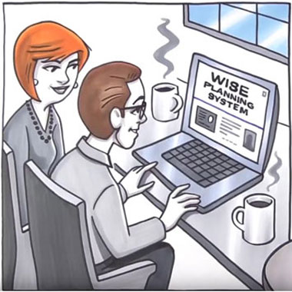
INDUSTRY LEADING FUNERAL PLANNING SOLUTIONS
Do-it-Yourself Preplanning
  Manage Funeral Costs
  Choose Funeral Services
  Directory of Preferred Providers
  Plan Ceremonies
  Record Vital Information
  60,000 “Quick Plans” Created
  Advisor-Led Funeral Planning
  Get Preplanning Assistance
  Learn About Prepayment Options
6
Notes:
At the heart of Funeralwise is our funeral planning solutions including a state-of-the-art planning system for do-it-yourselfers where they can manage their funeral costs, choose funeral services, and search our directory of funeral homes and cemeteries. If they so choose, they can plan their funeral ceremonies in detail and record vital personal information that can be used for eulogies and an obituary, and for wrapping up one’s personal affairs.
As I mentioned earlier, Funeralwise also offers the expert assistance of Preplanning Specialists to help with funeral planning. That’s what we do. Many of our clients are not do-it-yourselfers so we help them create their funeral plans and offer funding solutions.
A family in the Funeralwise user community that has done their planning could walk into an arrangement conference with you with much the information needed to make their arrangements and the funding in place to pay for it. At that point, they are your client. We do not offer licensed funeral services.

Slide 7

THE FUNERALWISE NETWORK
OF PLANNING SPECIALISTS
Funeralwise Resources
  The Wise Planning System
  Lead Generation Programs
  Collateral Materials
  Legal Forms
  Email Campaigns
  Premier Preneed Resources
  Funeral Home Lead Generation Programs
  Premier 360 System
7
Notes:
As part of the Funeralwise network of preplanning specialists, we have use of an unparalleled toolkit of resources that we can use to bring business to you. We have exclusive back office use of the Funeralwise Wise Planning System, it’s lead generation programs, collateral materials, and sophisticated email campaigns. In addition to funeral planning, we can help people create essential legal documents such as a will and advance directives. We do this all for free.
In addition, the network gives us access to the excellent funeral home marketing resources of Premier Preneed, a marketing affiliate of Funeralwise. I’ll tell you about those resources and how they will benefit you in just a few minutes.

Slide 8
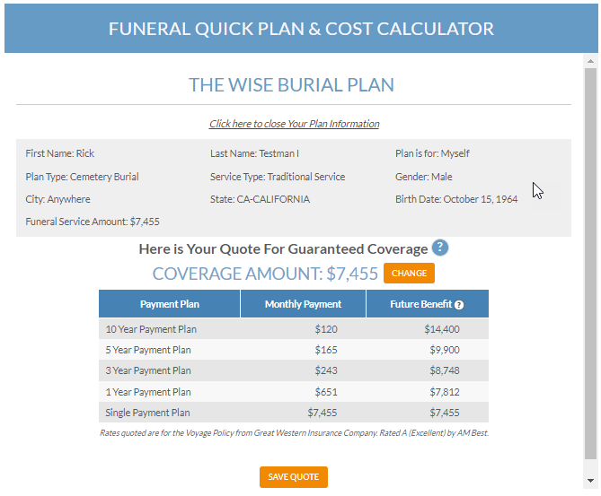

GREAT WESTERN
PRENEED INSURANCE
Planning-based Approach
  Quotes based on estimated funeral cost.
  Link policy to a Funeral Service Contract of a Preferred Provider
  Great Western Policies
  Voyage Series
  Course Series
8
Notes:
We offer Great Western preneed insurance policies to fund our client’s funeral plans. As you know, Great Western is one of the leading insurance companies offering preneed insurance. Our clients see us as planning advisors not insurance agents because we take a planning-based approach. We use the Funeralwise planning tools to create funeral plans for our clients and estimate their funeral costs. We are then able to offer a Great Western policy to fund the funeral plan which can be tied to a preneed contract for funeral services and products.

Slide 9

GREAT WESTERN
VOYAGE SERIES
Extraordinary Voyage Features
  Death benefit is total premium paid or face amount plus GWIC growth rate, whichever is greater.
  Death benefit never less than premiums paid in.
  Offered in Single Premium, 1-year, 3-year, 5-year, and 10-year plans.
  Two simple health questions to qualify for first-day coverage.
  Due to excellent return of premium there may be extra money for other final expenses.
9
Notes:
Among the reasons we like Great Western is their Voyage Series policy. It’s a one-of-a-kind policy with excellent growth. At some point we would welcome an opportunity to dive into the details of Voyage and explain how it would benefit you. In the interest of time, we can leave that for another meeting.

Slide 10
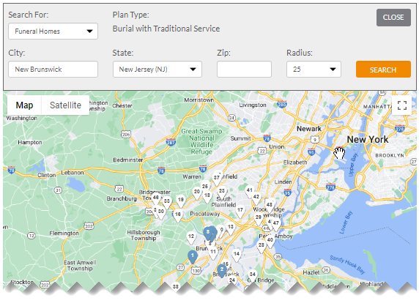
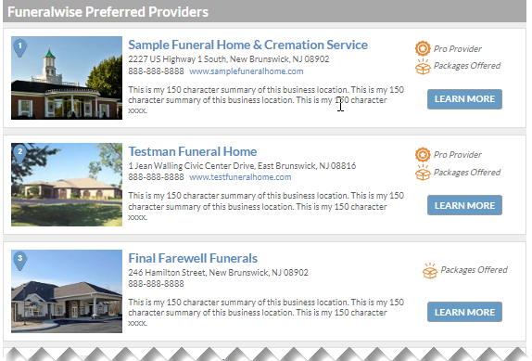
THE PREFERRED PROVIDER NETWORK
Featured Listings in Provider Directory on Funeralwise.com
10
Notes:
As we have discussed, Funeralwise brings together the consumer and the funeral industry. One way we do that is through the Funeralwise Preferred Provider program. Preferred Providers get featured listings on the Funeralwise website and in the Wise Planning System. I can set up your funeral home with a free Preferred Provider account. There is no obligation. Think of it as a modern day version of the old phone book Yellow Pages. Back in the day, every funeral home needed a Yellow Pages listing.

Slide 11
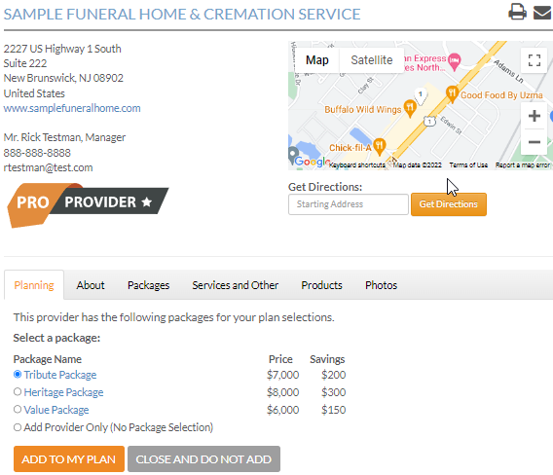
PREFERRED PROVIDER DETAILS
Detailed Web Listing
  Preferred Providers control their listing.
  Listing of packages and prices is optional.
  Pro Providers get top listings and case referrals.
  Preferred Provider can be added to a person’s funeral plan in the Wise Planning System.
11
Notes:
As a Preferred Provider you will have online access to your listing so it will be under your control. We offer a Pro Plan for funeral homes that are working with us. That does not have to be an exclusive relationship. It could be as simple as being willing to accept a preneed or at need case from us. The users of our Wise Planning System can find you in our search directory and add you to their funeral plan. As advisors we can connect you with our clients.

Slide 12
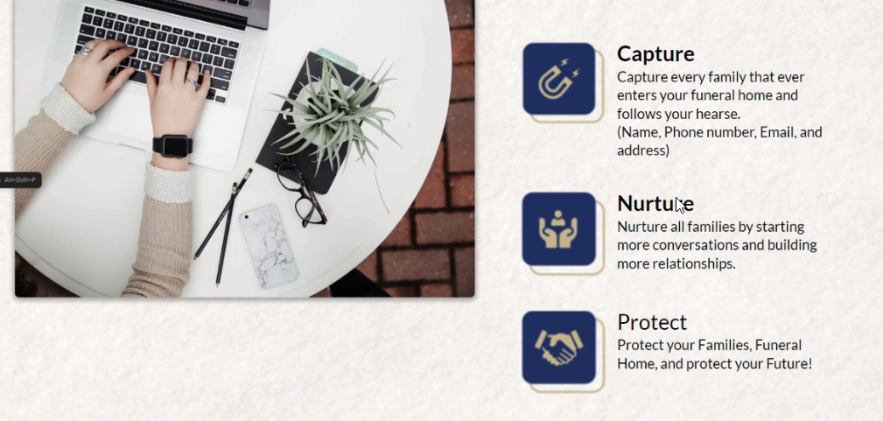

FUNERAL HOME MARKETING
Notes:
In addition to the benefits of the Preferred Provider program and our services as Planning Specialists, you can take advantage of the funeral home marketing services of Premier Preneed. If you are willing to accept preneed cases from us with our preneed insurance funding, then you can also receive Premier Preneed’s impressive array of marketing services. This is made possible by the Funeralwise – Premier Preneed affiliation. Premier Preneed’s marketing services help you capture leads, nurture your relationship with them and make them loyal client families.

Slide 13
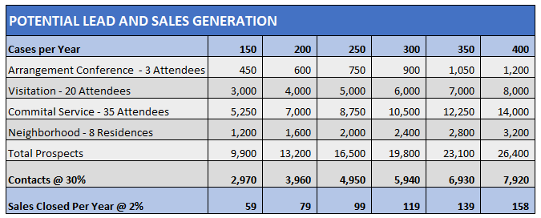
LEAD AND SALES GENERATION
A Multi-faceted Program to Maximize Leads and Sales
Notes:
So, what’s the potential benefit of our funeral home marketing programs? This chart provides several ways we can help generate leads and sales just by focusing on the people who walk through your door, including the family you are providing service to, the people attending visitations and services, and even neighbors of the family being served. Let’s look at the programs we offer to take full advantage of your current case volume.

Slide 14
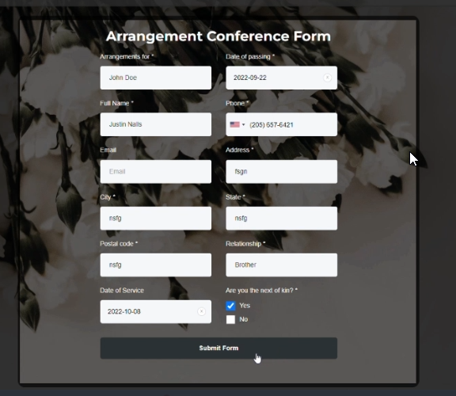
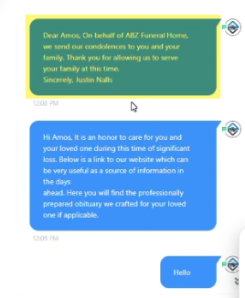
ARRANGEMENT DATA CAPTURE
Capture arrangement attendees and follow up
Notes:
We can capture arrangement data from your existing system, if you have one, or by using our Arrangement Conference Form. The arrangement data feeds the Premier 360 System where we begin following up by text and email.

Slide 15

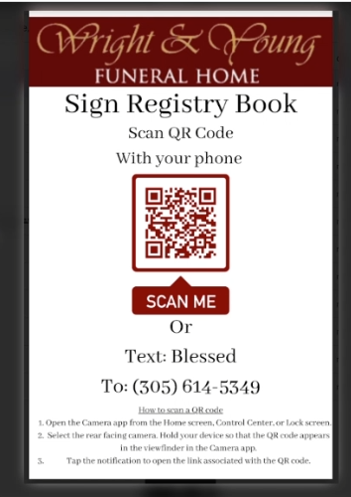
CAPTURE IN-PERSON ATTENDEES
Capture service attendees via QR code
Notes:
Rather than having attendees sign a Register Book we can capture their data on forms that are available on kiosks or via QR codes that will open a form when scanned. The QR codes can be included on print materials such as Memorial folders. With the attendee data in our system, we can create a beautifully printed Register Book to deliver to the family. Also, the attendees will then be prospects in the system for follow up.

Slide 16
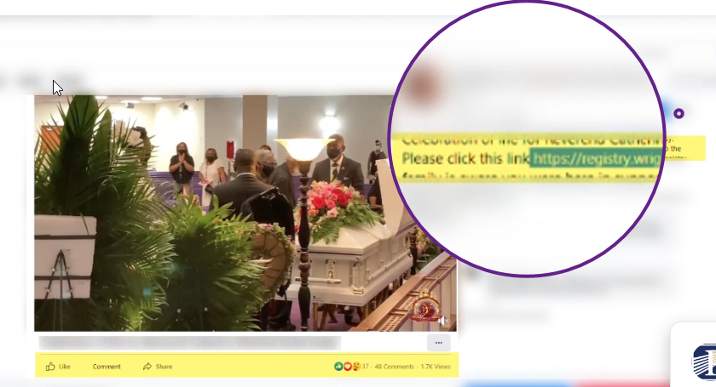
CAPTURE VIDEO STREAMING ATTENDEES
Provide link to Registry Entry form
Notes:
Video streaming is now how many people attend a funeral or memorial service. We can provide a link on the video stream that those watching remotely can click to access the registry form and enter their information. This ensures that both in-person and virtual attendees can be captured.

Slide 17
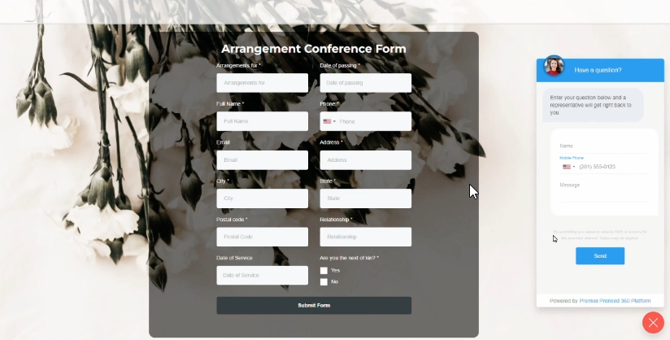
ONLINE CHAT SERVICE
Live and automated Chat on your website
Notes:
To support your customer service Premier Preneed offers a Chat feature that you can put on your website. Live customer service representatives will answer general questions and forward others to you. Automated responses are also available.

Slide 18
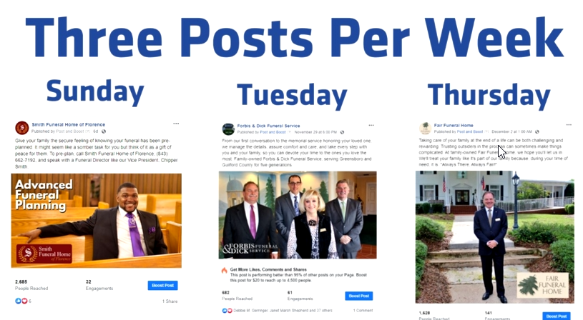
SOCIAL MEDIA MARKETING
“Faces on Facebook”postings
Notes:
The Premier Social Media Service is designed to expand your connection to your community, build your brand reputation and to grow your preneed business. The program features a series of postings on Facebook featuring your people and your services thereby enabling your community to know and trust you.

Slide 19
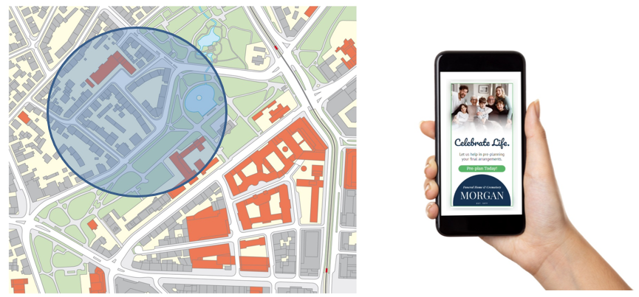
GEO LOCATION MARKETING
Digital display ads to selected local areas
Notes:
Known as geofencing, this form of location marketing uses GPS and other means to target people with digital ads within a defined geographic radius. This could be a radius around your funeral home, a church, a cemetery or any neighborhood that you choose. For example, people in the defined area might see your ads if they are on Facebook.

Slide 20

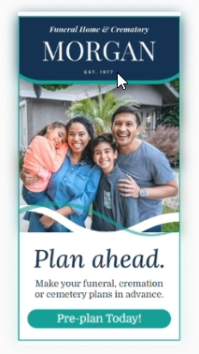

DIGITAL ADVERTISING
Artwork for digital display ads
Notes:
Premier Preneed offers various digital advertising campaigns including the artwork for display ads.

Slide 21
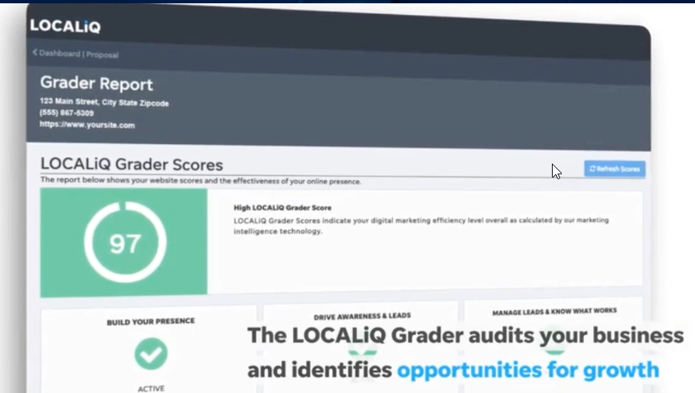
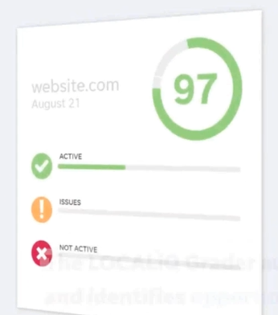
LOCAL MARKETING BY LOCALIQ
Digital Marketing Services provided by LocaliQ
Notes:
Through Premier Preneed, you’ll be able to take advantage of the local marketing expertise of LocaliQ. Their specialists will audit your existing web presence and assist with your local marketing. Also, they can help you qualify for Google’s new offering for the funeral industry – Local Service Ads. LSA’s are currently being offered for other industries like home repair services. With LSA’s you pay for actual leads rather than the traditional way of paying per click or per impression.

Slide 22
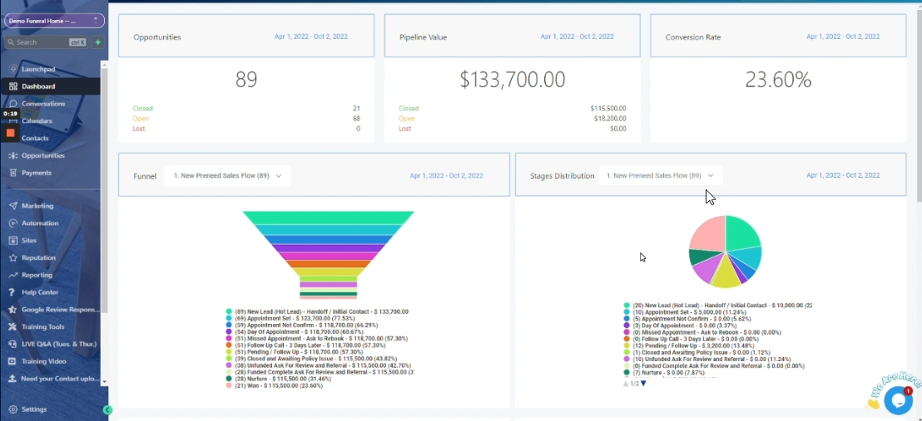
CUSTOMER RELATIONSHIP
MANAGEMENT SYSTEM
The Premier 360 System
Notes:
All of the data collected through these various programs is captured in the powerful Premier 360 System. The tools of 360 enable relationships to be cultivated, nurtured and maintained. That will produce sales now and in the future.

Slide 23

LET’S WORK TOGETHER!
Notes:
That was a fairly quick overview of who we are and what we have to offer. I’m sure you have questions and I’m happy to discuss them now. Also, I can arrange additional presentations to go into more detail on any or all of the things we just ran through. The bottom line is that we would welcome an opportunity to work with you.

